Slide 1
Xero - Final Presentation
Team 2
Ketan Patel - QA Manager Dhruv Khara - Business Analyst Grishma Pandiyath - Business Analyst Vedant Vivek Gadre - QA Analyst Dunstan Anthony Peter D’souza - QA Analyst Hrishikesh Shah - Software Tester Abhishek Sharma - Software Tester Om Sanjay Patel - Software Tester Kiran Kumar Vasala - Software Tester

Slide 2
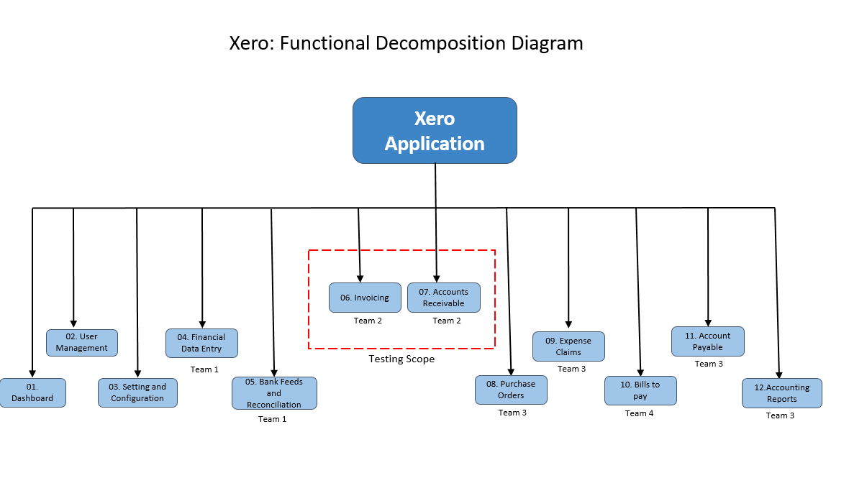
Functional Decomposition Diagram (by Abhishek Sharma)

Slide 3
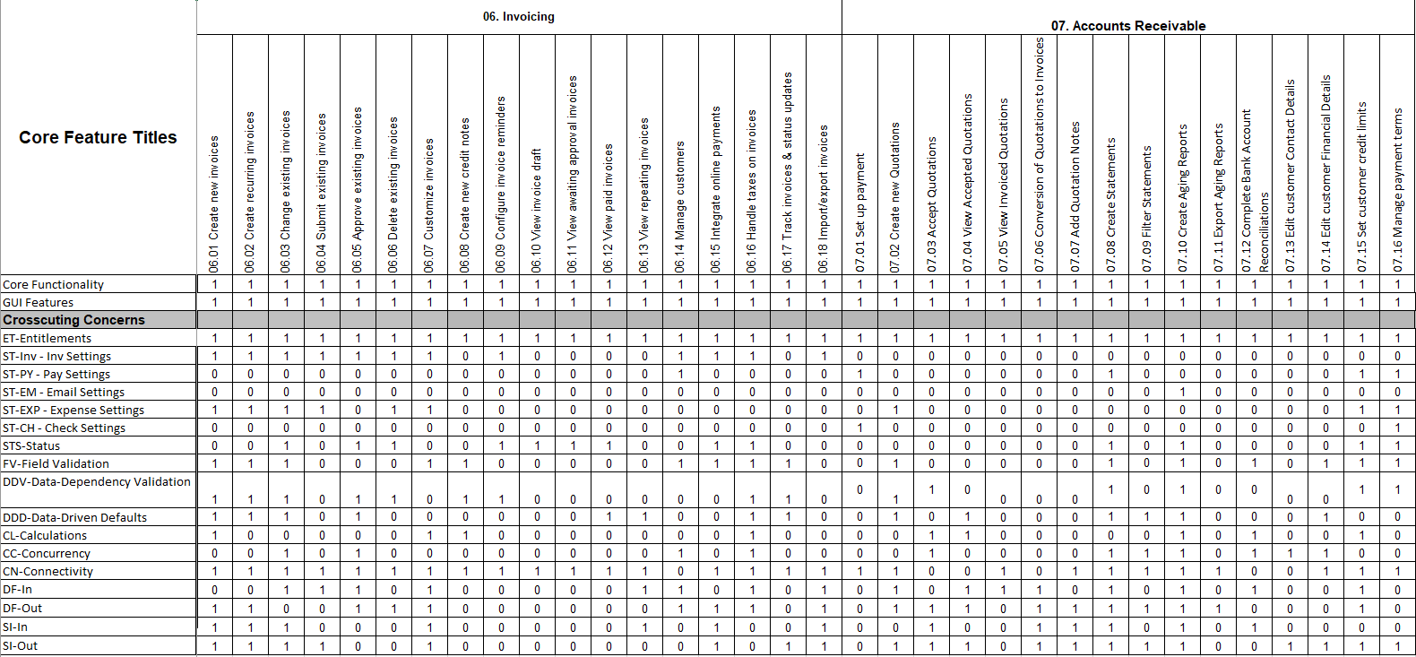
RCT (presented by Ketan Patel)

Slide 4
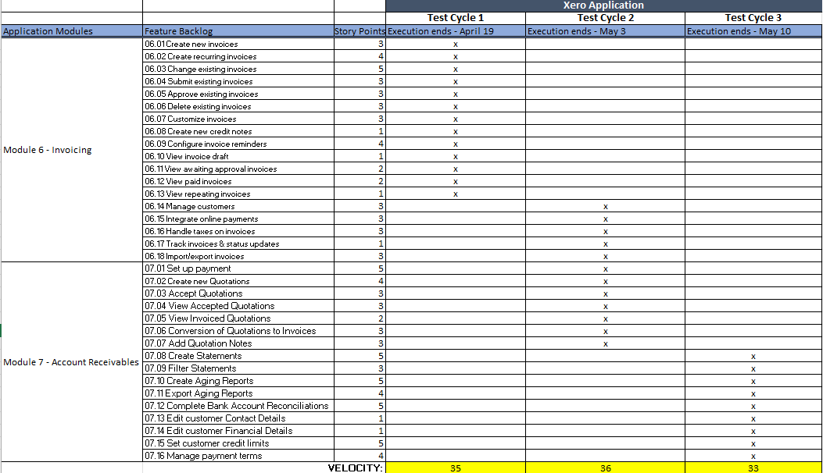
Testing RoadMap (presented by Om Patel)

Slide 5
Test Plan Document (presented by Dhruv Khara)
Test Scope:
Functional Area: Xero Web Application
Focus: Invoicing and Accounts Receivable Modules[06 and 07]
Technical scope: Web Browser, Application server, Database server
Test Objectives:
Validate functional & non-functional requirements
Core Features: Invoice creation, management, quotations, reporting
Non-Functional: Performance, security, usability, compatibility
Test Process:
Plan, Design, Preparation, Execution, Report
Black-box testing approach
Entry/Exit Criteria defined

Slide 6
Test Plan Document (presented by Dhruv Khara)
Test Environment:
Dedicated QA environment isolated from production
QTest for test management, version control
Data privacy measures in place
Roles & Responsibilities: QA Manager, QA Analyst, Business Analyst, Software Tester
Test Cycles & Schedule:
Cycle 1 (Apr 19): Invoicing Module Functionality
Cycle 2 (May 3): Customer & Quotation Management
Cycle 3 (May 10): Financial Reporting & Customer Management
Risks & Contingencies:
Too many acceptable defects will lower the overall quality
Personnel and testing resource constraints

Slide 7
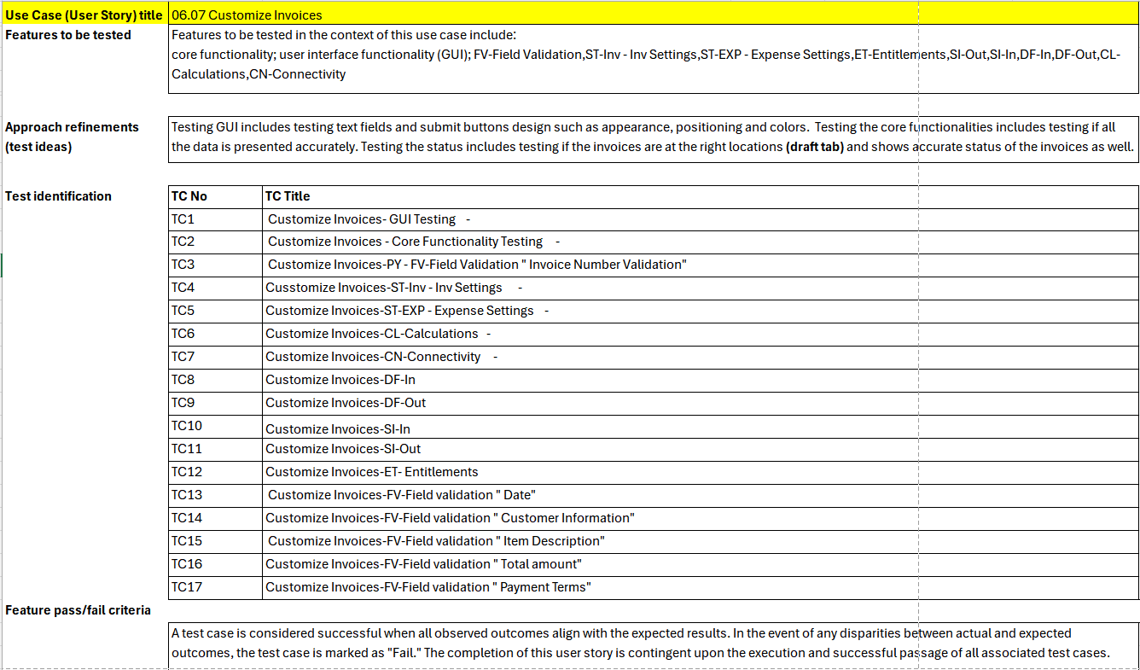
Test Design Specification (presented by Hrishikesh Shah)

Slide 8
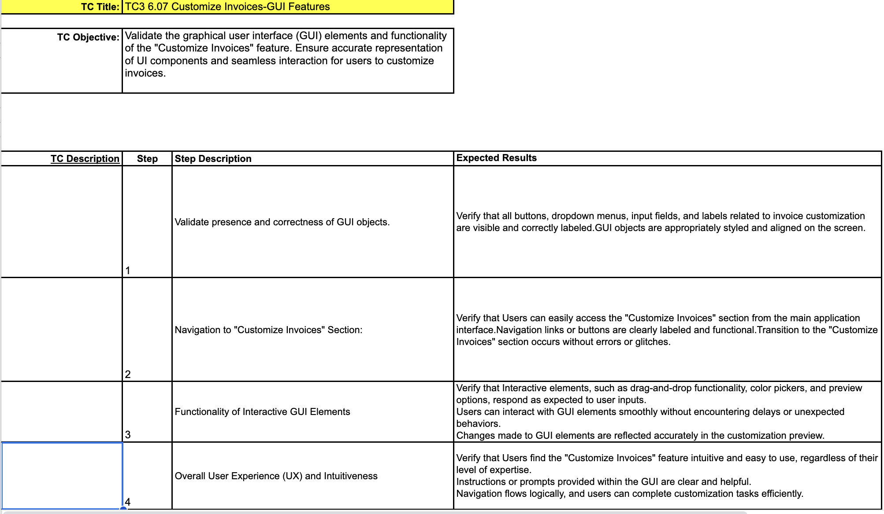
Test Cases Specification (presented by Vedant Gadre)

Slide 9
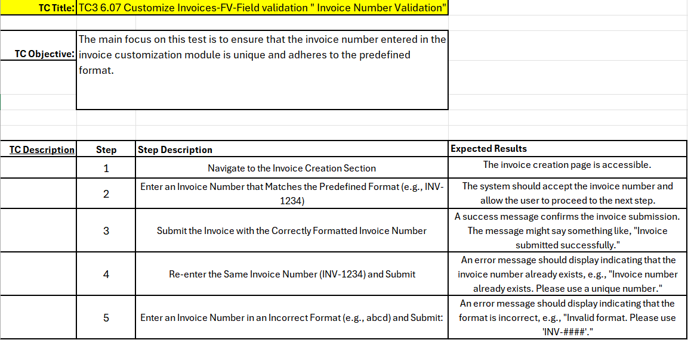
Test Cases Specification (presented by Dunstan Dsouza )
Tip: System should display a [negative] condition when you leave a mandatory field blank.

Slide 10
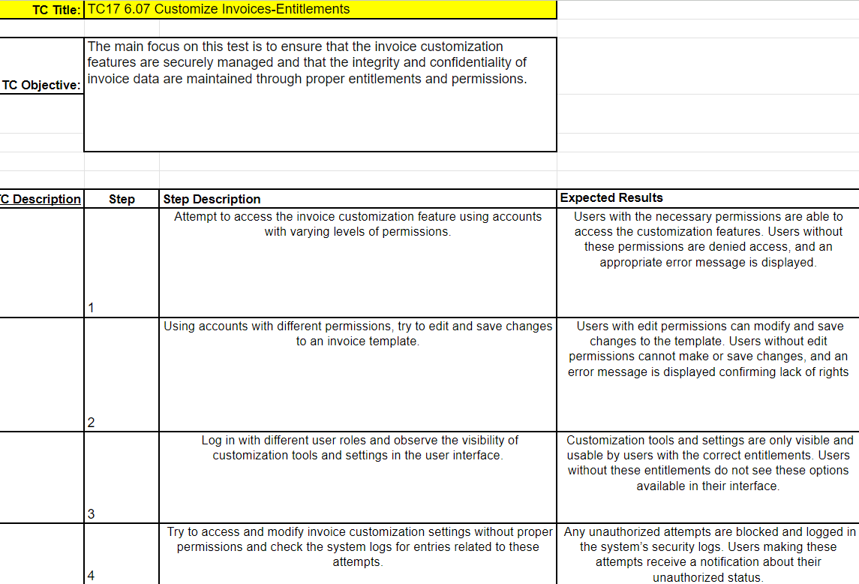
Test Cases Specification (presented by Dunstan Dsouza )

Slide 11
Test Summary Report (presented by Kiran)
Introduction:
The Test Summary Report serves as a comprehensive documentation of testing activities conducted throughout the software development lifecycle. It communicates the outcomes of testing, including the number of test cases executed, pass/fail status, and identified defects' severity. Additionally, it evaluates whether testing objectives have been met, assesses software quality, and provides decision support for stakeholders. The report plays a crucial role in ensuring transparency, accountability, and confidence in the software development process, serving compliance and audit purposes while informing stakeholders about the software's readiness for deployment.
Metrics:
Test Cases Executed - 119 , Test Cases Passed - 109 , Test Cases Failed - 10
Types of Testing Performed:
Functional and Usability are the major types of testing performed.
Performance testing with minimal user count of 7-9.

Slide 12
Test Summary Report (presented by Kiran)
Test Management and Defect Logging Tools :
JIRA and qtest
Browsers:
Chrome, Firefox, Safari, Brave
Best Practices:
Detailed documentation - Thorough documentation of test cases, procedures, and outcomes ensures clarity and transparency throughout the testing process.
Utilizing the testing tools efficiently - Proper utilization of testing tools such as JIRA and qTest optimizes testing workflows, improves productivity, and facilitates collaboration among team members.
Effective bug reports and tracking - Comprehensive tracking of bugs ensures that no issues are overlooked and helps maintain a clear audit trail of bug resolution activities.
Lessons Learnt:
Set realistic deadlines and track the progress efficiently.
RCT Accuracy - Ensuring accuracy in Requirement Traceability Matrix (RCT) helps maintain alignment between test cases and project requirements, minimizing the risk of missing test coverage and enhancing overall testing effectiveness.

Slide 13
Test Summary Report (presented by Kiran)
Exit Criteria:
● All test cases have been executed. – Yes
● All test cases have passed or have acceptable justifications for failures. – Yes
● All defects have been reported and verified. – Yes
● All defects of Critical, Major, and Medium severity are either resolved or will make an acceptable mitigation plan. – Yes
Conclusion:
The Testing team confirms the application's readiness for deployment after meeting all exit criteria, ensuring comprehensive testing of the Invoicing and Account Receivables modules in the Xero application

Slide 14

Recorded Application Demo(Recorded by Grishma Pandiyath)

Slide 15
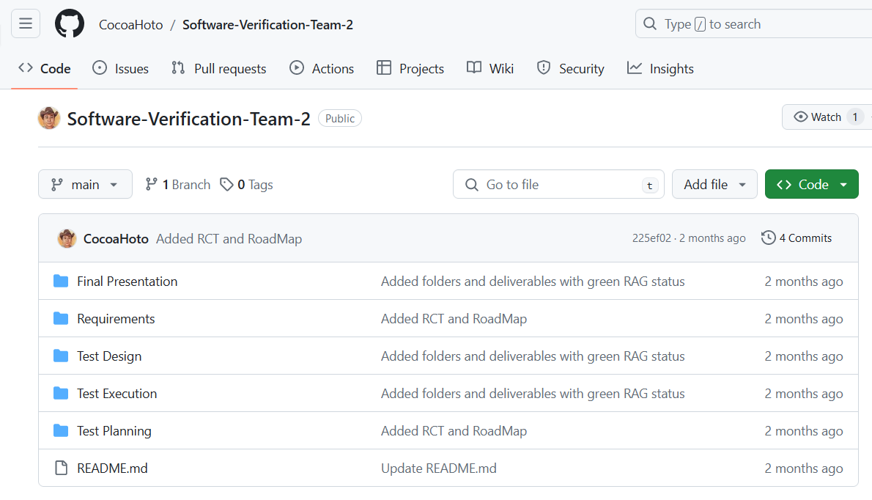
Github Repository
- https://github.com/BeLazy167/CS631G-Software-Verification-Team-2

Slide 16
Thank You!
Team - 2

